Slide 1
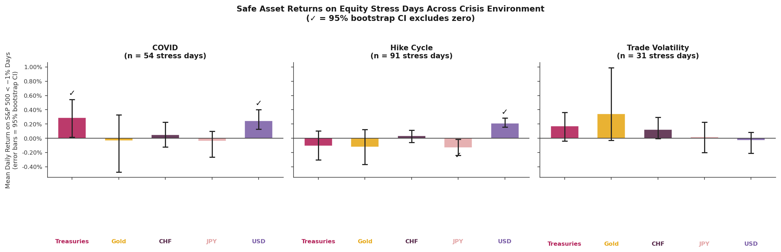
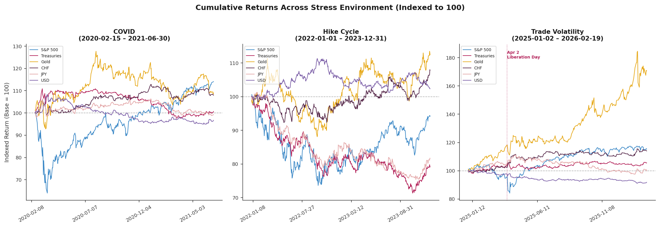
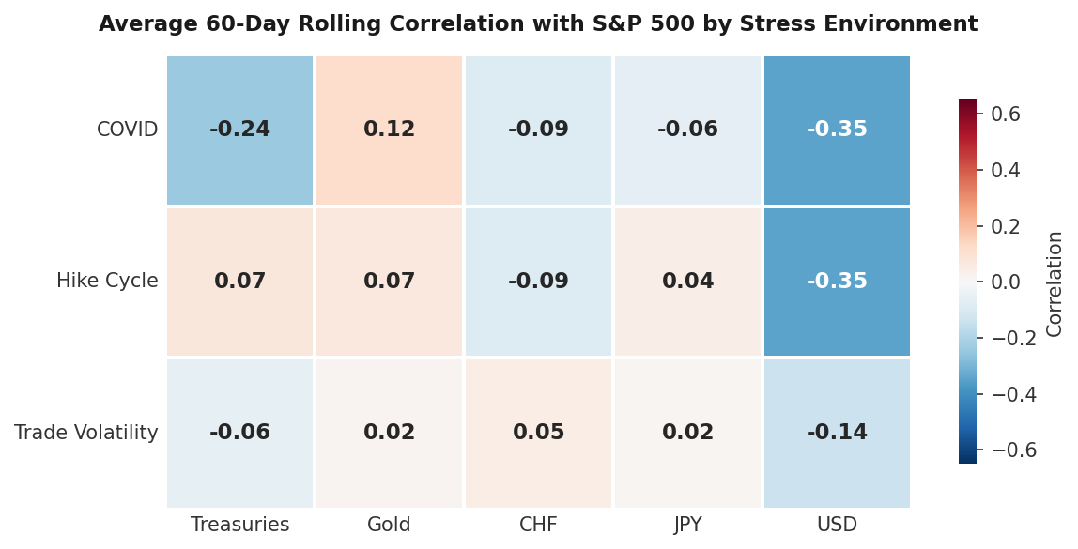
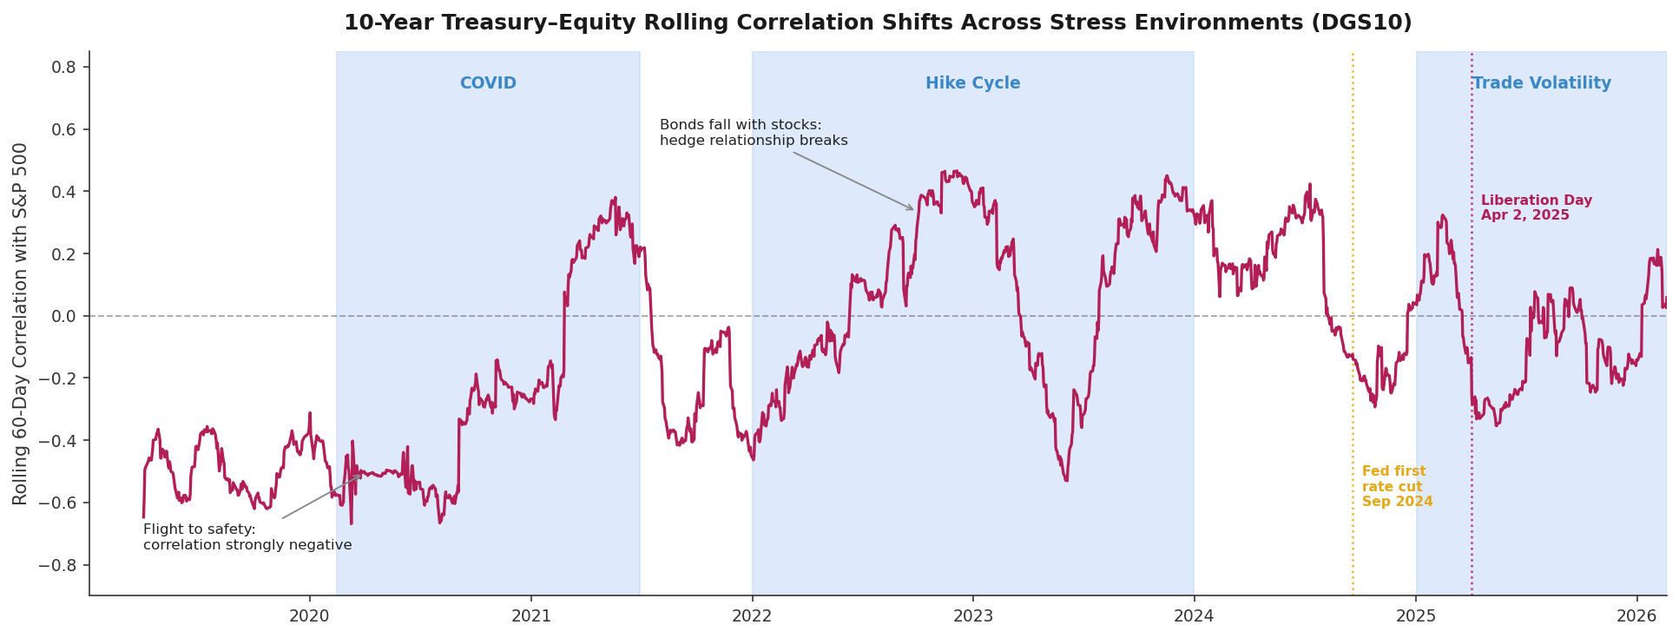

The Hedge That Flipped: Safe-Asset Performance Across COVID, Rate Hikes, and Trade Volatility
Yousra Belgaid Woods College of Advancing Studies, Boston College
Abstract
Which safe assets protect investors when equities fall? Does that answer depend on what is driving the crisis? Using daily data from 2019 to 2026, this study evaluates the hedging performance of the US 10-year Treasury, Gold, the Swiss Franc (CHF), the Japanese Yen (JPY), and the Broad USD Index across three stress environments: the COVID market shock, the Federal Reserve rate hike cycle, and the ongoing trade volatility period.
Results of this study reveal that hedging performance is deeply conditional on the nature of the crisis. Treasuries were a reliable hedge during COVID but failed entirely during the rate hike cycle, as rising yields caused bonds and equities to fall together. Gold delivered strong cumulative returns across regimes but provided no reliable protection on acute stress days. The broad USD Index was the only asset to hedge consistently across multiple stress environments, until trade volatility, when it broke down as the United States became the source of the shock itself. These findings suggest that no single asset is a universal hedge. Which asset protects, and which fails, depends on the economic conditions driving it.
Results
No single asset consistently hedged equities across all three stress environments. The same asset that protected in one environment actively failed in another. During COVID, Treasuries and the Broad USD Index were the only statistically significant hedges. By the rate hike cycle, Treasuries failed almost entirely, and the Broad USD index stood alone. By trade volatility, even the dollar broke down, leaving no asset with a statistically reliable hedge. JPY turned significantly negative during the hike cycle, driven by the US-Japan rate differential widening to multi-decade highs, where investors borrowed cheaply in Yen to fund Dollar assets, actively suppressing the Yen demand even on equity stress days.
Stress-Day Performance (Bootstrapping Analysis)
Daily stress-day returns are serially correlated, consecutive bad days are not independent observations, which cause t-test to overstate significance. Block Bootstrapping (block size = 5; B =10,000 replications) preserve this autocorrelation structure, producing 95% confidence intervals for mean stress-day returns. A “✓” indicates the confidence interval excludes zero and the asset hedged with statistical confidence.
In the chart below, we can see that Gold averaged +0.345% during trade volatility but its wide confidence intervals [-0.034%, +0.975%] spans zero, statistically unreliable on acute stress days. Yet its cumulative performance tells a completely different story.
Discussion
The Yield Channel
The hedge relationship between Treasuries and equities is not driven by the stress environment, it is driven by the direction of yields.
COVID: The Fed cut rates to zero and launched unlimited QE, suppressing yields and allowing Treasuries to rise alongside falling equities (+0.289% on stress days, Figure 2)
Rate Hike Cycle: Starting from historically low yields of near 1.5% the Fed raised rates by 400 basis points in a single year, bond prices collapsed as yields surpassed 4%, producing one of Treasuries' worst annual losses (−20.9% cumulative, Figure 3)
Supply pressure: Quantitative tightening reduced Fed demand while deficit spending kept supply elevated. Major foreign holders including China and Japan simultaneously reduced their Treasury holdings, amplifying the sell-off
The Fed's first rate cut on September 18, 2024, partially restored the negative Treasury–equity correlation (visible in Figure 1).
The Broad US Breakdown
The Broad USD Index was the most consistent hedge across two consecutive stress environments, until the United States itself became the source of the shock.
Rate Hike Cycle: As the Fed raised rates by more than 400 basis points, faster than any other major central bank, global capital flowed into dollar-denominated assets for yield and stability (+0.211% on stress days, Figure 2).
Trade Volatility: The dollar fell over 9% in 2025, its worst annual performance since 2017. Sweeping tariffs, threats to Fed independence, and the longest government shutdown in US history eroded confidence in dollar-denominated assets (−8.2% cumulative, Figure 3)
The "Sell America" trade: When the shock originates from US policy itself, the dollar loses its safe-haven demand, foreign investors began selling American assets rather than buying them, reversing the safe-haven flow (−0.030% on stress days, Figure 2)
Asset Level Dynamics
Not every asset failed or succeeded for the same reason, as each responded to its own structural driver.
JPY: The Yen turned significantly negative during the rate hike cycle (−0.132%, Figure 2) because of a simple trade: when US interest rates are much higher than Japanese rates, investors borrow cheaply in yen and invest in higher-yielding dollar assets. This "carry trade" meant the yen was actively being sold, even on days when equities were falling, making it the opposite of a safe-haven during this period
Gold: Despite being the strongest cumulative performer across all three regimes (+70.7% during trade volatility, Figure 3), Gold failed to provide reliable protection on individual stress days in any crisis. Gold moves slowly and steadily in response to long-term uncertainty (tariffs, geopolitical risk, dollar weakness).
Conclusion
This study aims to explore a simple question: which safe assets protect investors when equities fall? The answer is, it depends. Treasuries and the Broad USD Index were reliable during COVID but broke down when yields rose and when the United States itself became the source of the shock. Gold rallied strongly, delivering +70.7% cumulatively during trade volatility while failing on individual stress days.
The deeper finding is this: safe asset performance is conditional on the economic environment driving the crisis. Specifically, the direction of yields, the origin of the shock, and the structural incentives facing global investors at any given moment. As trade policy continues to reshape global capital flows and the role of the dollar as a reserve currency faces renewed scrutiny, the question this study raises is: if long-duration bonds are not always a cushion, and the dollar cannot always be trusted, what truly qualifies as a safe-haven?
Introduction & Significance
In 2022, one the the most reliable relationships in portfolio management broke down. For decades, US Treasuries rose when equities fell. This negative correlation formed the foundation of the classic 60/40 portfolio. Then, as the Federal Reserve began its most aggressive rate hike cycle, bonds and stocks fell together. The hedge flipped. This study asks why, and whether other safe assets held where Treasuries failed.
This study examine five assets: The 10-Year Treasury (DGS10, FRED), Gold, the Swiss Franc (CHF), the Japanese Yen (JPY), and the Broad USD Index (DTWEXBGS, FRED), using daily return data from January 2019 through February 2026 across three stress environments:
The three regimes were selected to represent fundamentally different economic shock types and yield environments. The COVID shock captures a more panic driven collapse with near zero rates and massive fiscal stimulus. The rate hike cycle represents the sharpest Fed tightening in four decades, while the trade volatility period, which is anchored by Liberation Day (April 2, 2025), when sweeping US reciprocal tariffs triggered an immediate repricing across all asset classes captures policy uncertainty with no clear yield direction.
Methods
Stress-day Returns: Mean daily returns on S&P500 < -1% days, block-bootstrapped 95% CI (block size = 5; B =10000)
Rolling Correlations: 60-day rolling correlation between each asset and the S&P 500.
Treasury Returns approximated using a modified duration: r = −D × Δy, where D = 10/(1+y), applied to daily DGS10 yield changes
Asset (n=stress days) | COVID (n=54) | Rate Hike Cycle (n=91) | Trade Volatility (n=31)
Treasuries | +0.289% ✓ | -0.108% | +0.171%
Gold | -0.035% | -0.122% | +0.354%
CHF | +0.052% | +0.036% | +0.124%
JPY | -0.038% | -0.132% ✓ | +0.018%
Broad USD | +0.244% ✓ | +0.211% ✓ | -0.030%
Table 1. Summary of mean stress-day returns by asset and regime. ✓ = 95% bootstrap CI excludes zero; all other results are statistically insignificant.
Figure 2. Mean daily returns for each asset on S&P 500 < −1% days across three stress regimes, with 95% block-bootstrapped confidence intervals. ✓ indicates the CI excludes zero.
Environment | Period | Driver
COVID Shock | Feb 2020– Jun 2021 | Panic, deflation, flight to cash
Rate Hike Cycle | June 2022 – Dec 2023 | Inflation, rapidly rising rates
Trade Volatility | Jan 2025– Feb 2026 | Tariff Escalation, Policy Uncertainty
Cumulative Returns
A fundamentally different story emerges here –
COVID: Gold (+9.0%) and CHF (+8.0%) led as panic and dollar weakness drove demand for stores of value. Treasuries gained only modestly (+0.7%) despite their strong stress-day performance.
Rate Hike Cycle: Treasuries (−20.9%) and JPY (−18.3%) fell in near-identical trajectories. The rising US rates eroded bond prices while widening US-Japan rate differentials suppressed yen demand. CHF defied the trend (+7.9%), backed by the Swiss National Bank's strategic pivot to a stronger franc to fight imported inflation.
Trade Volatility: Gold (+70.7%) dominated every asset across all three regimes, driven by tariff escalation and policy uncertainty. The Broad USD Index turned negative (−8.2%), a pretty unusual reversal as the United States itself becomes the source of the shock.
Figure 3. Cumulative returns for each asset indexed to 100 at the start of each stress regime. The dotted vertical line in the Trade Volatility panel marks Liberation Day (April 2, 2025).
Correlation Matrix + Descriptive Analysis
The same asset that moved against equities in one regime moved with them in another highlighting that the hedge relationship itself is regime-dependent.
The heatmap to the left shows the average 60-day rolling correlation between each asset and the S&P 500 across three stress regimes. Blue indicates hedging behavior (negative correlation with equities) while values near zero signal a breakdown in the hedge relationship.
References
Asset | Mean (Hike) | Std (COVID) | Std (Trade Vol) | Key Signal
Treasuries | -0.044% ✓ | 0.510% | 0.623% | Mean flips negative, volatility barely changes
Gold | +0.028% | 1.306% ✓ | 1.560% ✓ | Highest volatility – cumulative gains mask daily noise
CHF | +0.017% | 0.466% | 0.576% | Most stable volatility across all stress environments
JPY | -0.038% ✓ | 0.484% | 0.624% | Carry trade suppressed returns during hike cycle
Broad USD | +0.005% | 0.375% | 0.307% ✓ | Std shrinks – most predictable until trade volatility
Brunnermeier, Markus K. Flight-to-Safety Capital Flows and the Global Financial Architecture. Presentation at the Federal Reserve Bank of New York, Princeton University.
Eisenbach, Thomas, and Gregory Phelan. Fragility of Safe Asset Markets. Federal Reserve Bank of New York, 2022.
Li, Wenhao. "A Discussion of 'Fragility of Safe Asset Markets' by Thomas Eisenbach and Gregory Phelan." University of Southern California Marshall School of Business, October 2022.
Nam, Rafael. "Why the Dollar Fell Over 9% in 2025, and What to Expect in 2026." NPR, January 4, 2026.
Federal Reserve Board. "Federal Reserve Issues FOMC Statement." Board of Governors of the Federal Reserve System, September 18, 2024.
Clarida, Richard, Burcu Duygan-Bump, and Chiara Scotti. "The COVID-19 Crisis and the Federal Reserve's Policy Response." Federal Reserve Board Finance and Economics Discussion Series, 2021.
World Gold Council. "Gold's 2024 Performance Best in 14 Years." World Gold Council, 2025.
Figure 1. During COVID, the Treasury-equity correlation approached -0.6, consistent with the classic flight-to-safety dynamics. During the rate hike cycle, the correlation turned sharply positive as rising yields eroded bond prices and pressured equities simultaneously. The correlation briefly recovered as markets anticipated Fed cuts late in 2023, but has since oscillated near zero through the trade volatility period, showing no reliable hedge signal.
Figure 4. Daily return statistics reveal why some assets hedge reliably while others do not. Gold's high volatility across all regimes explains why its strong cumulative returns do not translate into reliable stress-day protection. A single large daily move can dominate the mean without representing consistent behavior.
Table 2. In calm markets, Treasuries rose roughly 0.14% for every 1% drop in the S&P 500, a reliable hedge. During the rate hike cycle, that relationship reversed: Treasuries fell alongside equities instead of rising.

